Slide 1
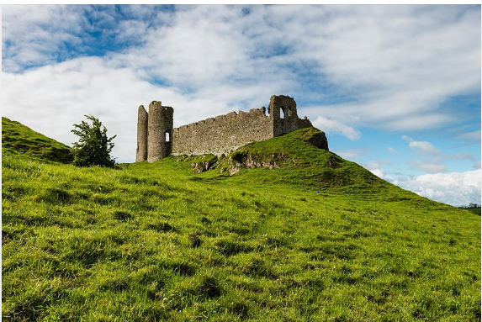
Roche Castle

Slide 2
Where is it?
It is near Dundalk Co. Louth.
It is 7 miles from my house.

Slide 3
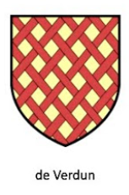
Who lived in it?
The De Verdun family.
Roesia De Verdun was one of the most powerful women in Ireland.

Slide 4
When was it built?
It was built in the Norman times.
I think it was built in 1236.

Slide 5
What did it look like?
It has twin towers and a gate house.
It was built on top of a rocky hilltop so people could not get at it.
The castle has been a ruin since 1641.

Slide 6
Cardboard model.
Materials: Easter egg box
toilet roll holder
fabric
glue

Slide 7
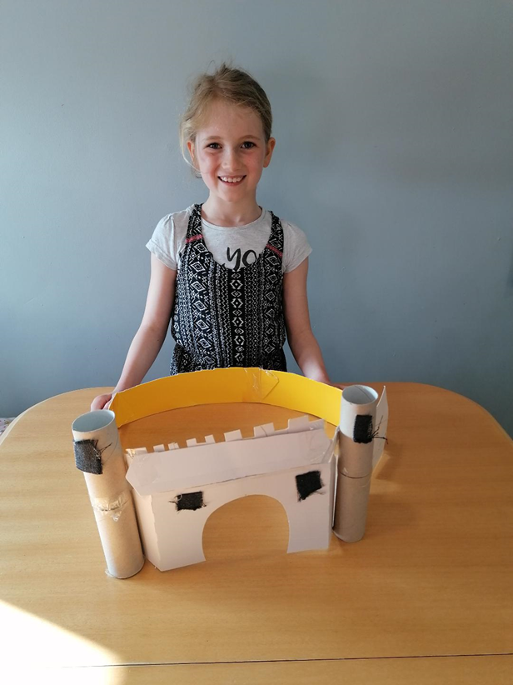
My model

Slide 8
The Murder Window
There is an old story about Roche Castle and the murder window. Roesia pushed her husband out of her bedroom window. She did it because she did not want to share her land.

