Slide 1
Castles In Ireland
Tandragree Castle
By Miceal O’Hanlon
P4

Slide 2
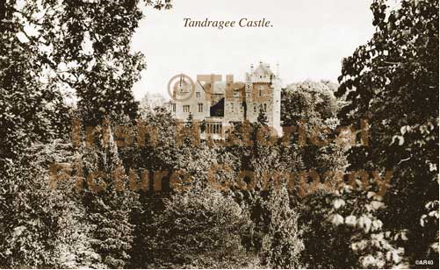
Tandragee Castle

Slide 3
Tandragee Castle
Introduction
There are approximately over 30,000 castles and ruins all over the Irish landscape. Some are large and well known like Bunratty castle or Blarney castle and more locally Bells castle now known as Killeavy Castle.
The castles were built by the powerful and the rich. The Anglo-normans first used fortifications when invading in Ireland, these soon developed into the castles and now the remains that we see today.

Slide 4
My Project
For my project I am going to research Tayto castle which is located in Tandragee. The reason for this is that it was once the site to the original stronghold of the O'Hanlon's, one of the most powerful clans in Ulster which was destroyed during the Irish rebellion of 1641 and remained ruined for two hundred years.
The current castle was built between 1830-1838 by the 6th Duke of Manchester and remained there Ulster seat until 1939.After this time it was leased to the US army during World War Two. It is said that General George S.Patton was a visitor to the castle in 1943 while inspecting troops in Northern Ireland he was a guest of honour at the castle.

Slide 5

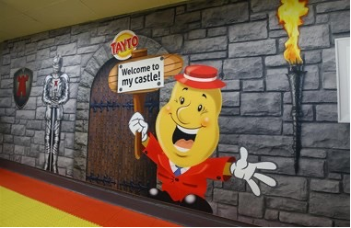
Tayto Castle
The 10th Duke of Manchester sold the site to its current owners in 1955 the Hutchinson family who developed the site into its current role as the manufacturing base of the world famous Tayto brand of crisps.
It is said that that within the castle is a closely guarded room where the unique Tayto cheese and onion Flavour recipe is kept.

Slide 6
Tayto Castle
I have not been to Tayto Castle but my mummy visited as a teenager with her friends on her summer holidays. The Tayto Castle tour was very interesting and they got lots of free crisps.
The inside of the Castle is quite modern in keeping with the food production.
I have drove through Tandragee many times in our way to Portadown and you can smell the crisps cooking. The smell is stronger in the summertime. I don't think I would like to live there with the smell every day as I play outside and practice my football skills.
The Castle looms over the small town of Tandragee and I am sure there are many ghosts. I would love to tour the castle at Halloween and meet the spirits.

Slide 7
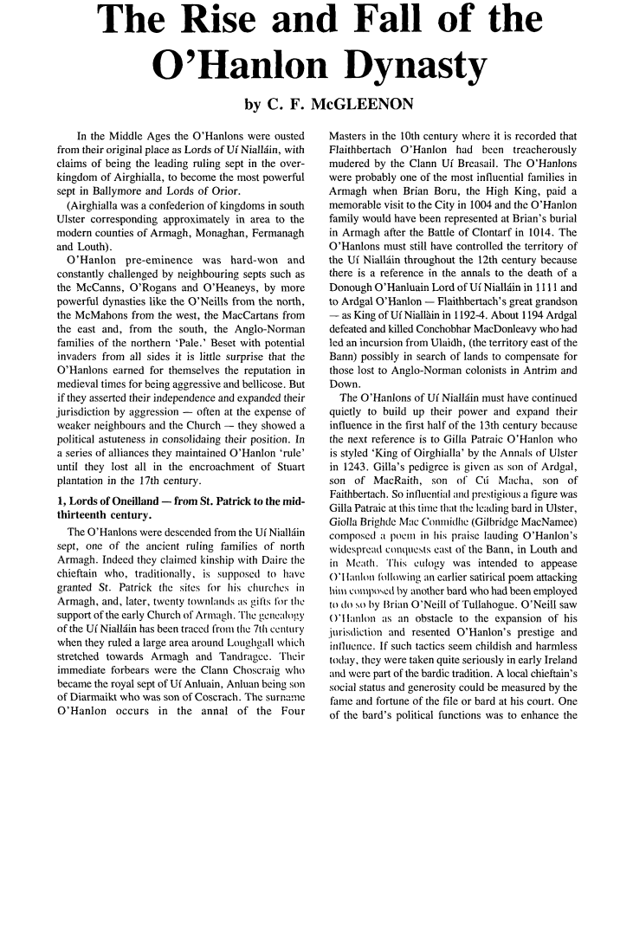

Slide 8
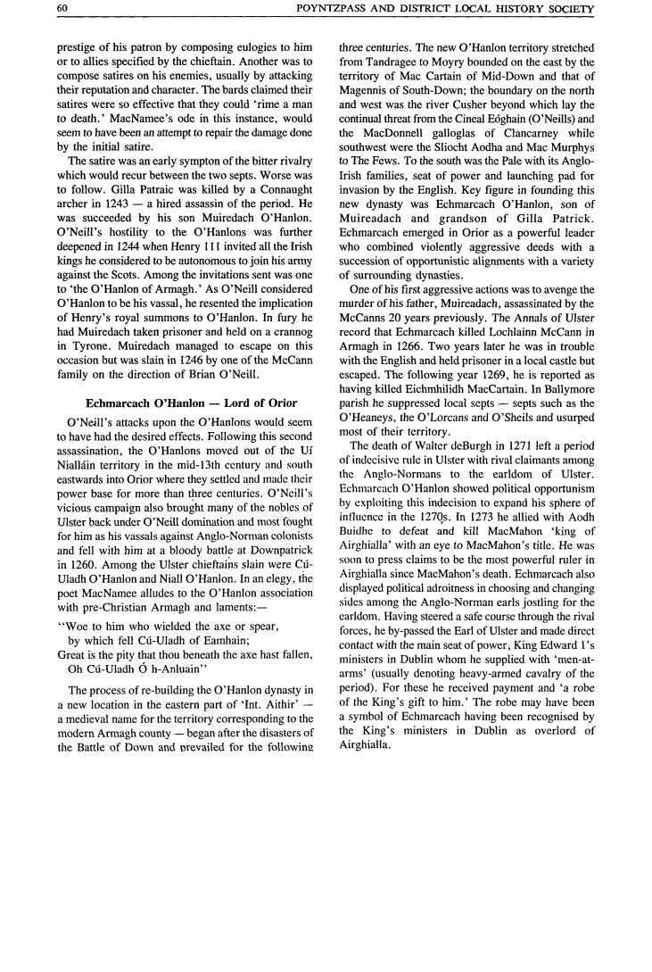

Slide 9
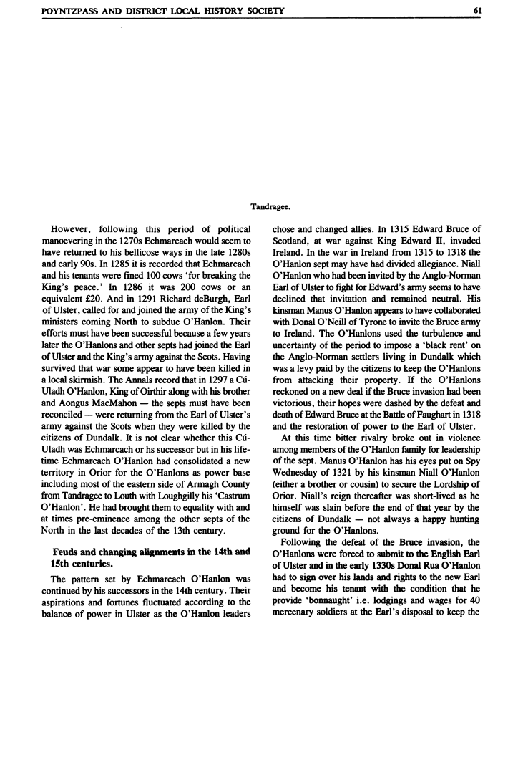

Slide 10
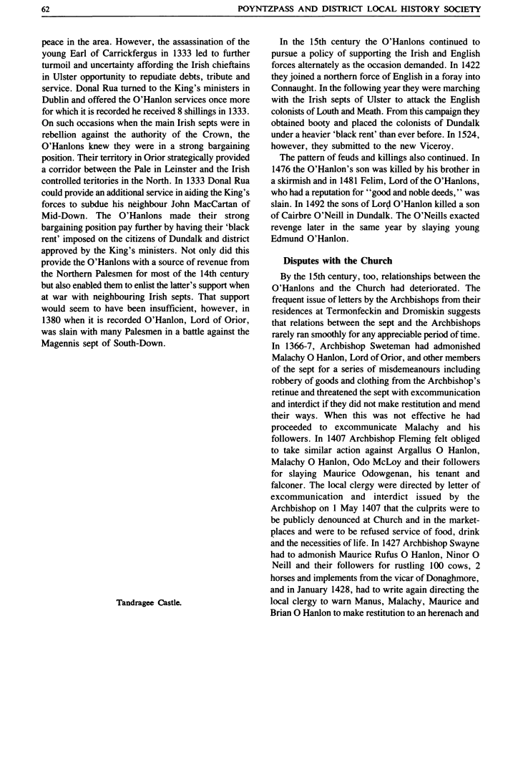

Slide 11
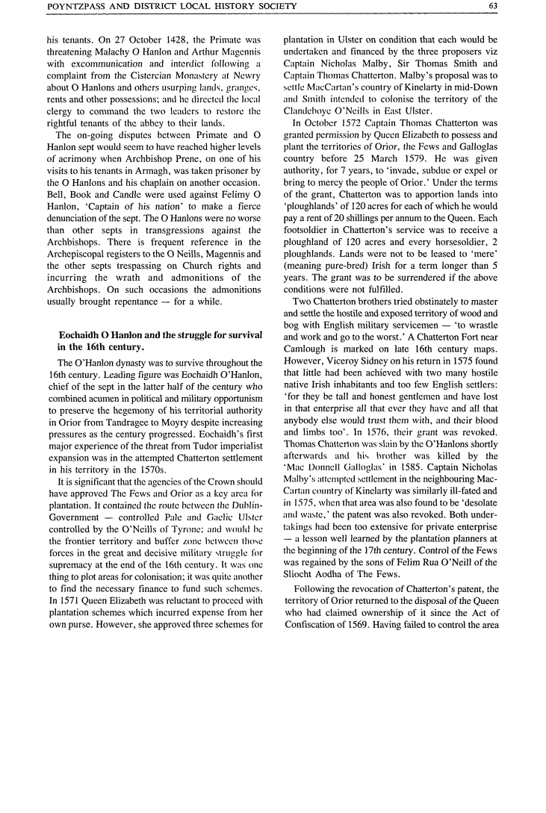

Slide 12
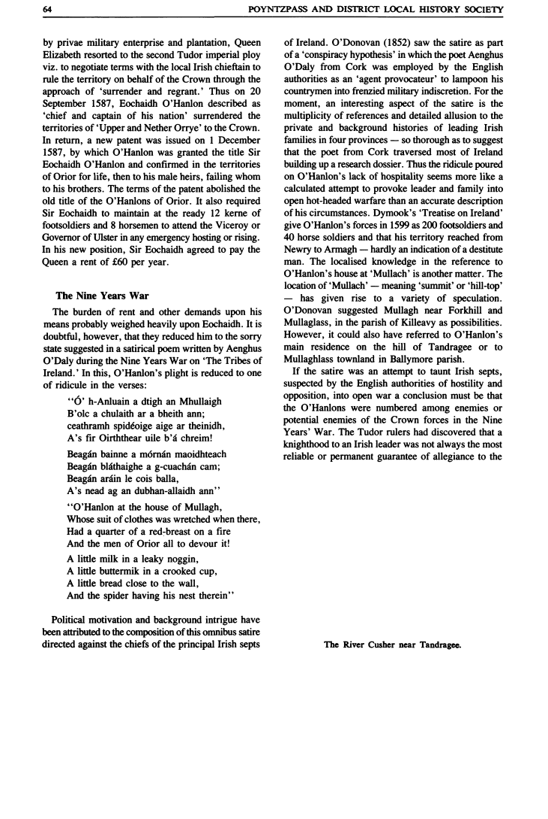

Slide 13
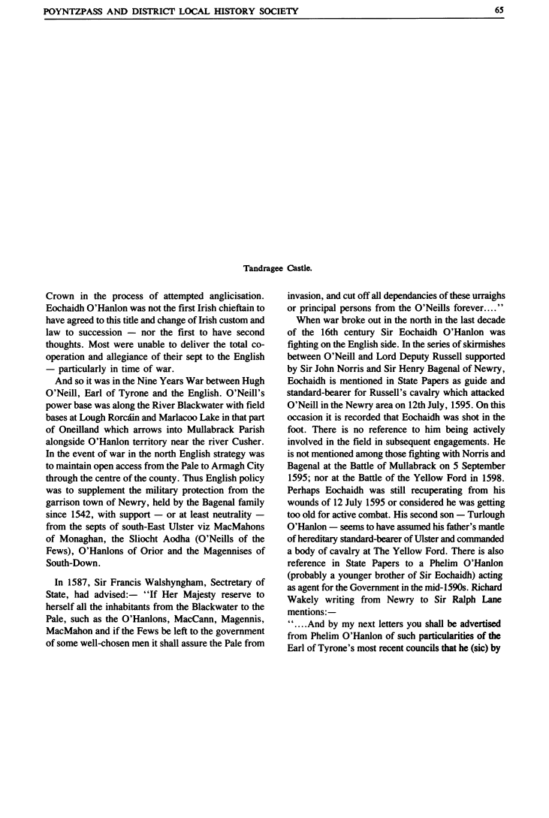
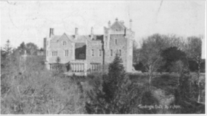

Slide 14
Medieval Ireland

Slide 15
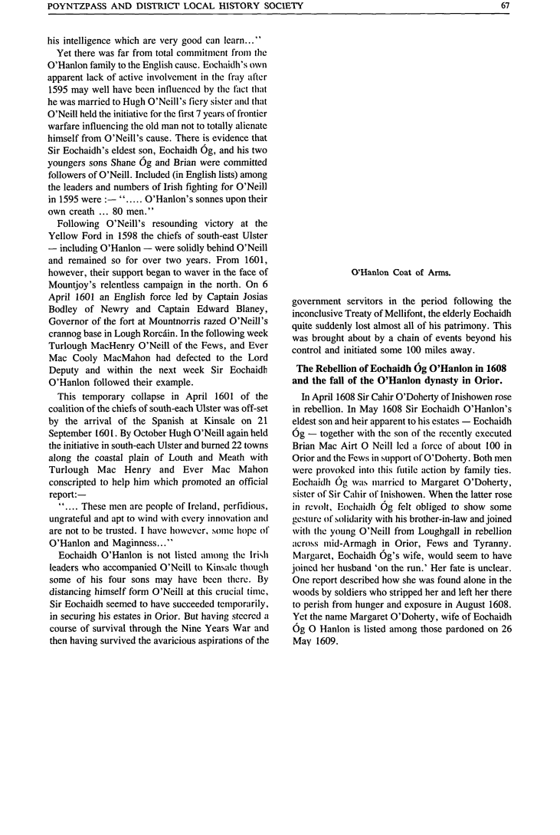

Slide 16
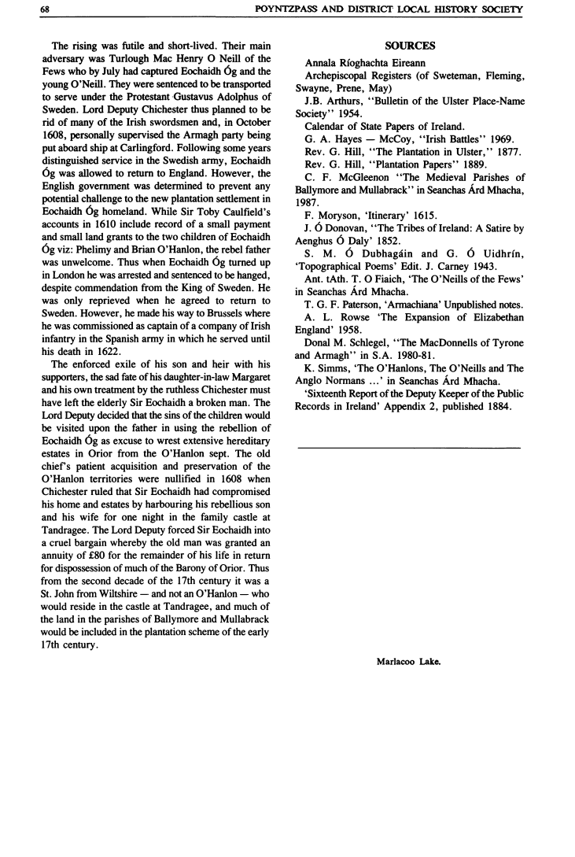

Slide 17
Co.Armagh Map.

